Slide 1
Recovery and Atomicity

Slide 2
Data may be monitored, stored, and changed rapidly and effectively using a DBMS (Database Management System).
A database possesses atomicity, consistency, isolation, and durability qualities.
The ability of a system to preserve data and changes made to data defines its durability. A database could fail for any of the following reasons:
System breakdowns occur as a result of hardware or software issues in the system.
Transaction failures arise when a certain process dealing with data updates cannot be completed.
Disk crashes may occur as a result of the system's failure to read the disc.
Physical damages include issues such as power outages or natural disasters.
The data in the database must be recoverable to the state they were in prior to the system failure, even if the database system fails.
In such situations, database recovery procedures in DBMS are employed to retrieve the data.

Slide 3
The recovery procedures in DBMS ensure the database's atomicity and durability.
If a system crashes in the middle of a transaction and all of its data is lost, it is not regarded as durable.
If just a portion of the data is updated during the transaction, it is not considered atomic.
Data recovery procedures in DBMS make sure that the data is always recoverable to protect the durability property and that its state is retained to protect the atomic property. The procedures listed below are used to recover data from a DBMS,
Recovery based on logs.
Recovery through Deferred Update
Immediate Recovery via Immediate Update
The atomicity attribute of DBMS safeguards the data state. If a data modification is performed, the operation must be completed entirely, or the data's state must be maintained as if the manipulation never occurred.
This characteristic may be impacted by DBMS failure brought on by transactions, but DBMS recovery methods will protect it.

Slide 4
What exactly is a Log-Based Recovery?
Every DBMS has its own system logs, which record every system activity and include timestamps for the event's timing.
Databases manage several log files for operations such as errors, queries, and other database updates. The log is saved in the following file formats:
The structure [start transaction, T] represents the start of transaction T execution.
[write the item, T, X, old value, new value] indicates that the transaction T changes the value of the variable X from the old value to the new value.
[read item, T, X] indicates that the transaction T reads the value of X.
[commit, T] signifies that the modifications to the data have been committed to the database and cannot be updated further by the transaction. There will be no errors after the database has been committed.
[abort, T] indicates that the transaction, T, has been cancelled.

Slide 5
We may utilize these logs to see how the state of the data changes during a transaction and recover it to the prior or new state.
An undo operation can be used to inspect the [write item, T, X, old value, new value] operation and restore the data state to old data. The only way to restore the previous state of data to the new state that was lost due to a system failure is to do the [commit, T] action.
Consider the following series of transactions: t1, t2, t3, and t4. The system crashes after the fourth transaction; however, the data can still be retrieved to the state it was in before the checkpoint was established during transaction t1.
After all of the records of a transaction are written to logs, a checkpoint is created to transfer all of the logs from local storage to permanent storage for future usage.

Slide 6
Shadow Paging
Shadow Paging is recovery technique that is used to recover database. In this recovery technique, database is considered as made up of fixed size of logical units of storage which are referred as pages.
pages are mapped into physical blocks of storage, with help of the page table which allow one entry for each logical page of database.
This method uses two page tables named current page table and shadow page table.
The entries which are present in current page table are used to point to most recent database pages on disk.

Slide 7
Another table i.e., Shadow page table is used when the transaction starts which is copying current page table.
After this, shadow page table gets saved on disk and current page table is going to be used for transaction.
Entries present in current page table may be changed during execution but in shadow page table it never get changed.
After transaction, both tables become identical. This technique is also known as Cut-of-Place updating.

Slide 8
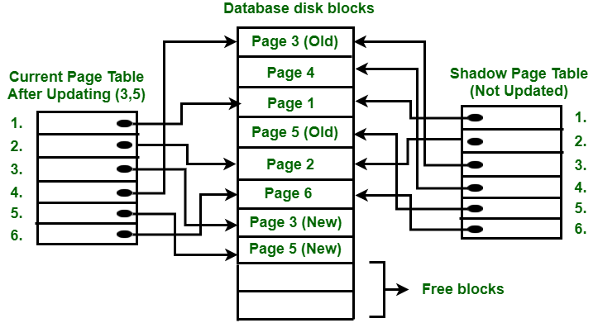

Slide 9
To understand concept, consider above figure. In this 2 write operations are performed on page 3 and 5. Before start of write operation on page 3, current page table points to old page 3. When write operation starts following steps are performed :
Firstly, search start for available free block in disk blocks.
After finding free block, it copies page 3 to free block which is represented by Page 3 (New).
Now current page table points to Page 3 (New) on disk but shadow page table points to old page 3 because it is not modified.
The changes are now propagated to Page 3 (New) which is pointed by current page table.

Slide 10
COMMIT Operation : To commit transaction following steps should be done :
All the modifications which are done by transaction which are present in buffers are transferred to physical database.
Output current page table to disk.
Disk address of current page table output to fixed location which is in stable storage containing address of shadow page table. This operation overwrites address of old shadow page table. With this current page table becomes same as shadow page table and transaction is committed.

Slide 11
Failure :
If system crashes during execution of transaction but before commit operation, With this, it is sufficient only to free modified database pages and discard current page table.
Before execution of transaction, state of database get recovered by reinstalling shadow page table.
If the crash of system occur after last write operation then it does not affect propagation of changes that are made by transaction.
These changes are preserved and there is no need to perform redo operation.

Slide 12
Advantages :
This method require fewer disk accesses to perform operation.
In this method, recovery from crash is inexpensive and quite fast.
There is no need of operations like- Undo and Redo.
Recovery using this method will be faster.
Improved fault tolerance: Shadow paging provides improved fault tolerance since it isolates transactions from each other. This means that if one transaction fails, it does not affect the other transactions that are currently executing.
Increased concurrency: Since modifications made during a transaction are written to the shadow copy instead of the actual database, multiple transactions can be executed concurrently without interfering with each other. This leads to increased concurrency and better performance.

Slide 13
Simplicity: Shadow paging is a relatively simple technique to implement. It requires minimal modifications to the existing database system, making it easier to integrate into existing systems.
No need for log files: In traditional database systems, log files are used to maintain a record of all changes made to the database. Shadow paging eliminates the need for log files since all changes are made to the shadow copy. This reduces the overhead associated with maintaining log files and makes the system more efficient.

Slide 14
Disadvantages :
Due to location change on disk due to update database it is quite difficult to keep related pages in database closer on disk.
During commit operation, changed blocks are going to be pointed by shadow page table which have to be returned to collection of free blocks otherwise they become accessible.
The commit of single transaction requires multiple blocks which decreases execution speed.
To allow this technique to multiple transactions concurrently it is difficult.
Data fragmentation: The main disadvantage of this technique is the updated Data will suffer from fragmentation as the data is divided up into pages that may or not be in linear order for large sets of related hence, complex storage management strategies.

Slide 15
Garbage collection: Garbage will accumulate in the pages on the disk as data is updated and pages lose any references. For example if i have a page that contains a data item X that is replaced with a new value then a new page will be created. Once the shadow page table is updated nothing will reference the old value of X. The operation to migrate between current and shadow directories must be implemented as an atomic mode.
Performance overhead: Since modifications made during a transaction are written to the shadow copy, there is a performance overhead associated with copying the changes back to the actual database once the transaction is committed. This can impact the overall performance of the system.
Limited concurrency control: Shadow paging does not provide strong concurrency control mechanisms. While it allows for multiple transactions to execute concurrently, it does not prevent conflicts between transactions. This means that transactions can interfere with each other, leading to inconsistencies in the database.

Slide 16
Difficult to implement for some systems: Shadow paging can be difficult to implement for some systems that have complex data structures or use a lot of shared memory. In these cases, it may not be possible to maintain a shadow copy of the entire database.
Limited fault tolerance: While shadow paging does provide improved fault tolerance in some cases, it does not provide complete fault tolerance. In the event of a crash, there is still a risk of data loss if the changes made during a transaction are not properly copied to the actual database.

